Slide 1

Microservice Architecture with Spring Boot
- Guru

Slide 2
Agenda
Introduction to Microservices
Monolithic vs. Microservices architecture
Benefits and Drawbacks
Ecosystem / Tools / Infrastructure
Microservices usecases
Microservices with Boot
Designing Microservices
Endpoints
Creating a Eureka Service
Synchronous and Asynchronous Communication
Microservices capability Model

Slide 3
Introduction to Microservices
Microservices is also known as the microservice architecture
An architectural style that structures an application as a collection of services.
Microservices = a collection of services
We break the entire application into smaller applications, each one can independently work
Such small applications can be developed, deployed and maintained independently.

Slide 4
Traditional Web Application Architecture
Consider an eCommerce application that takes orders from the customers, verifies the inventories and the customers’ credits and ships them
Example: Flipkart, Amazon etc.
In traditional method: We have many modules under one umbrella artifact (.war file)
Products module (Listing our products)
Customer details module (Maintaining customers)
Shopping module (add items to the cart)
Payment module

Slide 5
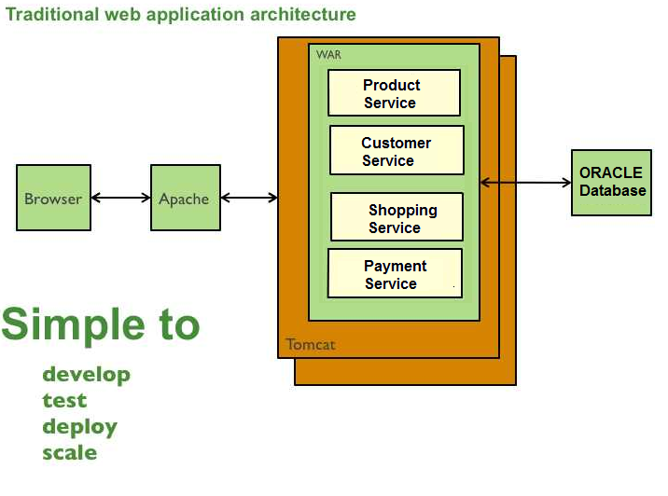
Traditional Web Application Architecture

Slide 6
Traditional Web Application Architecture - Issues
Assume the Payment Service is down
All other services would be down too
The other services (Product Service, Customer Service, Shopping Service) will not be accessible.
Reason?
All services are implemented a collection of Servlets / JSPs
These services are put into a single .war file
Either all services are available or none

Slide 7
Traditional Web Application Architecture - Issues
While the customer browse through the product list
They don’t need Payment service
They don’t need Shopping service
In a monolithic architecture, a single NullPointerException in a Product Service (for instance) is just enough to bring down the whole application.
So, the customers who want to browse the product list will be affected to a greater extend.

Slide 8
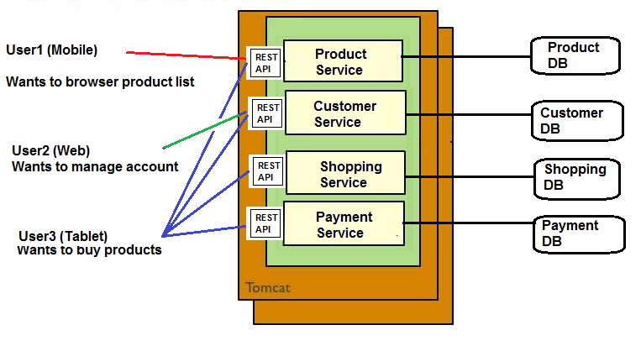
Microservices architecture
In Microservices architecture, the entire application is broken into smaller applications called services.
Enables SOC (Separation of Concerns)

Slide 9
Microservices - Benefits
Improved maintainability - each service is relatively small and so is easier to understand and change
Better testability - services are smaller and faster to test
Better deployability - services can be deployed independently

Slide 10
Microservices - Drawbacks
Developers must deal with the additional complexity of creating a distributed system:
must implement the inter-service communication mechanism and deal with partial failure
Implementing requests that span multiple services is challenging
Testing the interactions between services is more difficult
Implementing requests that span multiple services requires careful coordination between the teams
Developer tools/IDEs are oriented on building monolithic applications and don’t provide explicit support for developing distributed applications.

Slide 11
Microservices - Drawbacks
Deployment complexity. In production, there is also the operational complexity of deploying and managing a system comprised of many different services.
Increased memory consumption. The microservice architecture replaces N monolithic application instances with NxM services instances. If each service runs in its own JVM (or equivalent), which is usually necessary to isolate the instances, then there is the overhead of M times as many JVM runtimes.

Slide 12
When to use Microservices? - Usecases
Based on situation
During the first version of any application, this architecture is not needed (application is going to be relatively small & simple)
But, when the application evolves over period of time, developing distributed architecture will slow down the development viz.
Adding more features (you can’t pull the fat war files)
Need to scale individual modules/services
Autonomous team development is required
Devlopment, testing and deployment should not take more time

Slide 13
Ecosystem: tools and infrastructure
Infrastructure: Where should I host my microservices? (Amazon Web services, Azure, Oracle cloud etc.)
Orchestration: How should I manage the containers that host my microservices? (dockers, Kubernetes etc.)
API Gateways: How should I expose, secure and manage access to my microservices via APIs? Gate keeper between clients and microservices
Service Meshes: How should I manage the service-to-service communication between my microservices?
Serverless: Should I consider consuming cloud resources in a “pay-as-you-go” model or pre-purchase the capacity I need?
Security: How should I secure my containers and infrastructure?
Monitoring: How can I monitor the health and performance of my microservices and hosts?

Slide 14
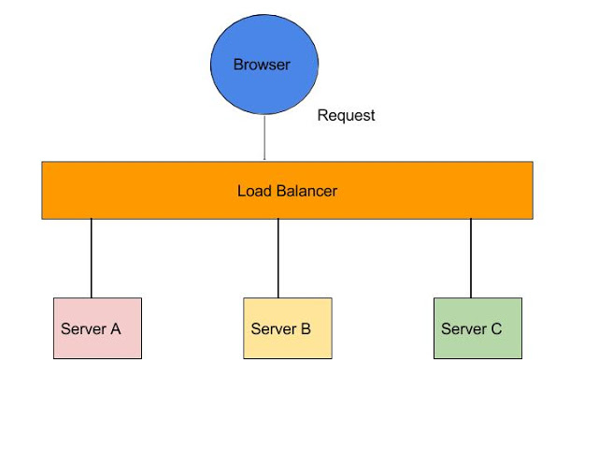
Server side Load Balancing such as Netscaler

Slide 15
Server side Load Balancing
In Java EE architecture, we deploy our war/ear files into multiple application servers,
then we create a pool of server and put a load balancer (Netscaler) in front of it, which has a public IP.
The client makes a request using that public IP, and Netscaler decides in which internal application server it forwards the request by round robin or sticky session algorithm.
We call it server side load balancing.

Slide 16
Server side Load Balancing - Problems
If one or more servers stop responding, we have to manually remove those servers from the load balancer by updating the IP table of the load balancer.
Another problem is that we have to implement a failover policy to provide the client with a seamless experience.
So, microservices DON’T USE SERVER SIDE LOAD BALANCING

Slide 17
Client Side Load Balancing
We will be using Eureka server for registering the microservices
It contains a list of registered microservices
If one microservice wants to communicate to another, it looks up the service registry using DiscoveryClient
Client side load balancing also maintains an algorithm like round robin or zone specific
Consul is another Microservices Discovery Server/tool

Slide 18
Client Side Load Balancing - Benefits
The service registry always updates itself
If one instance goes down, it removes it from its registry, so when the client side load balancer talks to the Eureka server, it always updates itself
So there is no manual intervention- unlike server side load balancing- to remove an instance.

Slide 19
What is Eureka?
Eureka is the Netflix Service Discovery Server and Client.
Eureka Server is using Spring Cloud.
When a client registers with Eureka, it provides meta-data about itself such as host and port, health indicator URL, home page etc.
Eureka receives heartbeat messages from each instance belonging to a service.
If the heartbeat fails over a configurable timetable, the instance is normally removed from the registry.

Slide 20
First microservice - HelloWorld
In this demo, we will see how to create a simple microservice that returns “HelloWorld”
We will register this microservice in Eureka server
We will start Eureka server
Then, we will create a program to discover this microservice and access it.

Slide 21
First microservice - HelloWorld
We need to create two maven project:
First Maven Project: Microservice-DiscoveryServer (could be any name)
This will be playing the role of microservice registry
When you run this project, it will show all the microservices listing in this registry
This is a registry application

Slide 22
First microservice - HelloWorld
2nd Maven Project: HelloWorldMicroservice
We will be creating the Controller classes with methods to map to specific URI
We will be returning either view or Response body from these methods based on HTTP method types (GET, POST, DELETE, PUT etc.)

Slide 23
First microservice - HelloWorld
In the Discovery Service project (Microservice-DiscoveryServer), we will create application.yml or application.properties file to specify the port #
In the HelloWorld microservice project, we create application.yml or application.properties file to specify the port#, name under which this microservice to be registered and the Discovery service access (URL of the 1st project)

Slide 24
First microservice – HelloWorld – pom.xml
We need the following dependencies in our pom.xml file (Discovery Service Server)
First, we need spring-boot-starter-parent
<parent>
<groupId>org.springframework.boot</groupId>
<artifactId>spring-boot-starter-parent</artifactId>
<version>1.5.3.RELEASE</version>
<relativePath/>
</parent>

Slide 25
First microservice – HelloWorld – pom.xml
We need the following dependencies in our pom.xml file (for Discovery Service Server)
spring-cloud-starter
spring-cloud-starter-eureka-server (for registration server)
But, Spring Cloud Starter Eureka Server (deprecated, please use spring-cloud-starter-netflix-eureka-server)

Slide 26
What is spring cloud?
Microservice infrastructure
Spring Cloud provides tools for developers to quickly build some of the common patterns in distributed systems (e.g. configuration management, service discovery, circuit breakers, intelligent routing, micro-proxy, control bus, one-time tokens, global locks, leadership election, distributed sessions, cluster state).
So, we need this in our dependency list.

Slide 27
First Microservice – HelloWorld Configuration (application.yml)
Create a file “application.yml” under /src/main/resources folder (Mainly the host and the port #)
# Configure this Discovery Server
eureka:
instance:
hostname: localhost
client:
registerWithEureka: false
fetchRegistry: false
# HTTP (Tomcat) port
server:
port: 4567

Slide 28
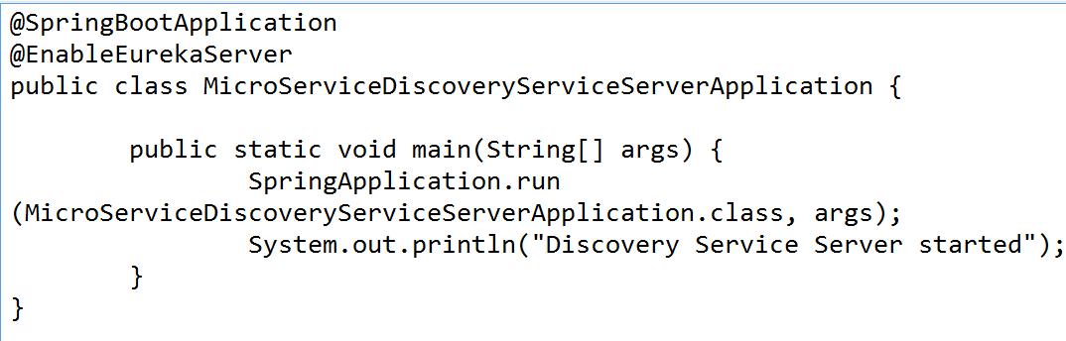
First Microservice – HelloWorld Main class
In order to run this registry server, we need to create a Java class as a Spring Boot Application and invoke run method:

Slide 29
First Microservice – HelloWorld Main class
Now, right click and run this main class as Spring Boot application
Then, open a browser and point to this URL:
http://localhost:4567/
You can see Eurkera server’s home page
At this point, no microservice has been registered, so you won’t see any microservice instance in Eureka’s home page

Slide 30
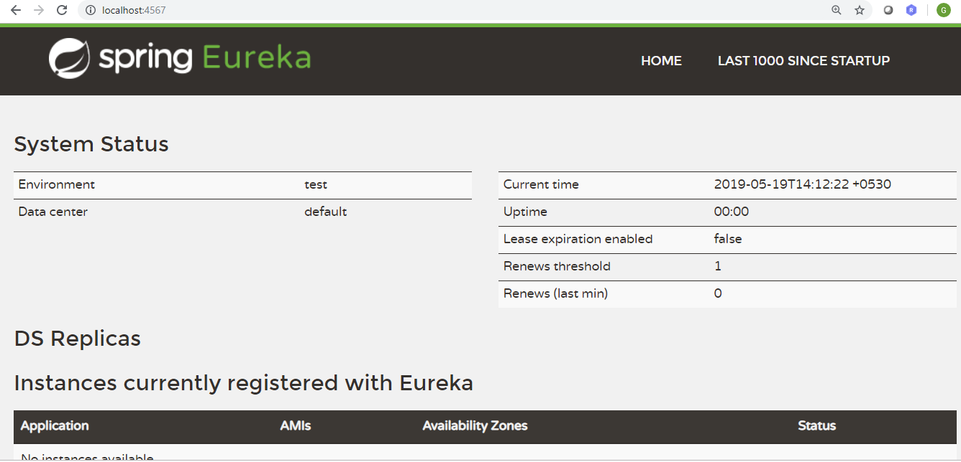
Viewing Eureka Home page

Slide 31
First Microservice – HelloWorld The producer
Now, let's create another Java project for producing HelloWorld microservice and registers in Eureka server.
Create Apache Maven project: Project name: HelloWorldMicroservice
Add the same dependencies in pom.xml from the previous project

Slide 32
First Microservice – HelloWorld Create Controller class
@RestController
public class HelloWorldController {
@RequestMapping("/hello")
public String sayHello()
{
return "Hello World Microservice";
}
}

Slide 33
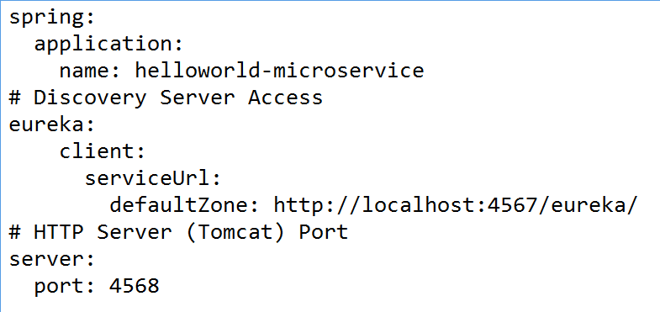
First Microservice – HelloWorld Configuration (application.yml)

Slide 34
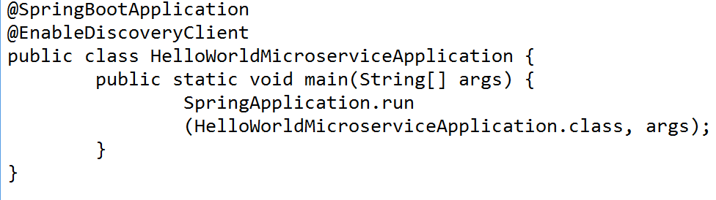
First Microservice – HelloWorld Main class (Application)
Run this as Spring Boot application
Open browser and point to http://localhost:4567/
You would see HelloWorld microservice is registered now ☺

Slide 35
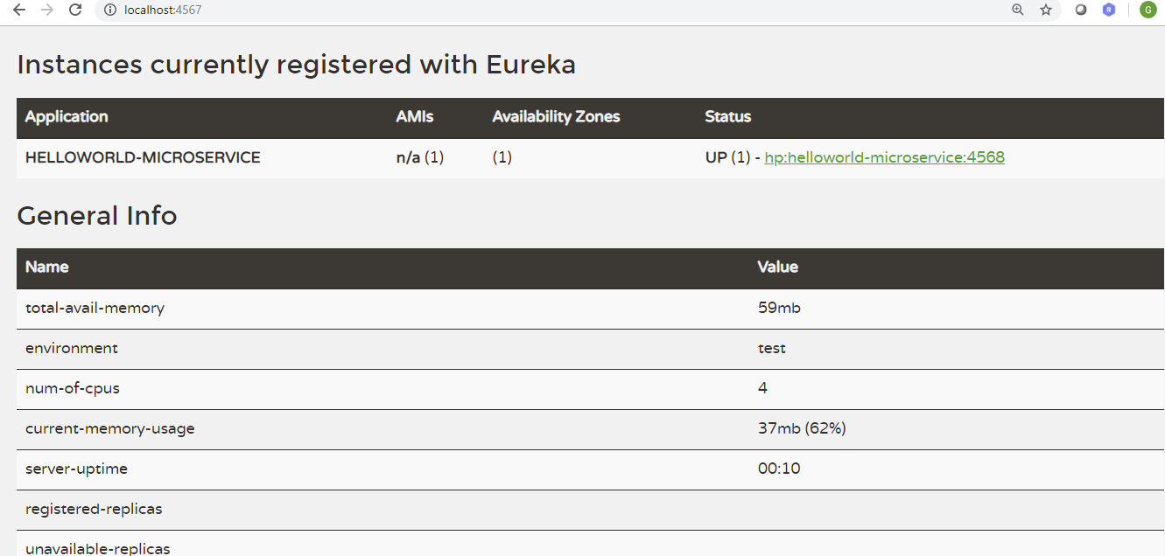
HelloWorld-microservice in Eureka listing

Slide 36
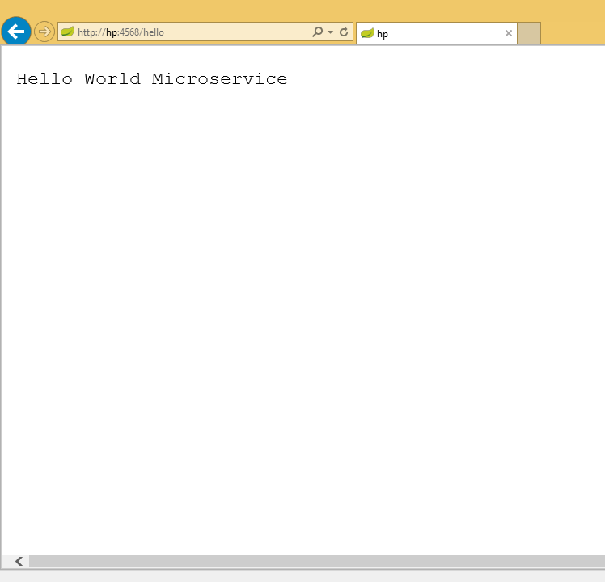
Accessing HelloWorld Microservice in browser

Slide 37
Various annotations we used
@EnableEurekaServer: Use in the Spring boot application class to enable the service registry
@SpringBootApplication: This mentions that the application is a Spring Boot Application
@EnableDiscoveryClient: Use this so that this microservice name can be discovered in the registry
Use this annotation mainly in the microservice class (not the service registry class)

Slide 38
Hands on
Create another microservice with the name “Welcome-microservice”
Define a controller class to map the following URI:
/info: Displays “This is welcome microservice” in <h1> tag
/welcome: Displays “Welcome” in <h1>tag
Register this in Eureka server
Verify that in browser, you see two microservices now and also access the above two URIs.

Slide 39
Case Study: Customer Portfolio Management
Let’s create the following two microservices:
Customer microservice to add, delete, update and list the customer details
Stock microservices to add, delete, update and list the Stock details
Verify these two microservices working independently

Slide 40
Case Study: Customer Portfolio Management Designing customer class
Customer class has the following properties
int customerId
String customerName
Address add (user defined class)
int stockIds[] (contains a list of stock ids)

Slide 41
Case Study: Customer Portfolio Management Designing Address class
Address class has the following properties
int flatNo
String streetName
String city
Long pinCode

Slide 42
Microservices communication
Take this use case:
A customer has 5 stocks with him/her
Customer details (name, address) are found in Customer microservice
Stock details (name, price) are found in Stock microservice
Now, we want to list out all stocks of a particular customer

Slide 43
Microservices communication
The REST API (end point) for this use case would be:
http://hp:1235/customers/{customerid}/stocks
The Customer microservice should first find out all stockids of the given customerid
We can write controller in Customer microservice to accomplish this

Slide 44
Microservices communication
Now, we have a list of stockIds of a given customerId
Let’s iterate all the stockIds from this array, give this stockId and get the stock details from Stock microservice (another microservice) as an ArrayList

Slide 45
Microservices communication
For somehow, the Customer microservice should know about Stock microservice
This can be easily obtained by looking at the exposed service url: http://STOCK-MICROSERVICE (application.yml file of Stock microservice)
Define a method in CustomerApplication that gives you an object of RemoteStockRepository (some meaningful name) by giving this service url in its constructor
Define another method in CustomerApplication that gives an object of RestTemplate class

Slide 46
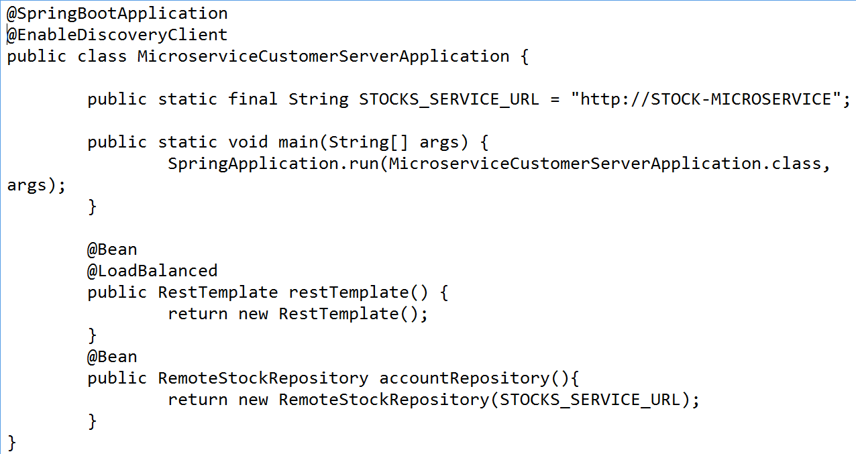
Microservices communication

Slide 47
Microservices communication - RestTemplate
RestTemplate is used to make HTTP Rest Calls (REST Client).
Usually, when you want to make an HTTP Call, you need to create an HttpClient, pass request and form parameters, setup accept headers and perform unmarshalling of response, all by yourself,
Spring Rest Templates tries to take the pain away by abstracting all these details from you.

Slide 48
Microservices communication - RestTemplate
There are six methods available:
public HttpHeaders headForHeaders(String, String)
pubilc ResponseEntity<String> exchange(URI, HttpMethod methodType, HttpEntity<String> entity, String.class)
public Object getForObject(String, Class, String)
public URI postForLocation(String, Object, String)
public void delete(String, String)
public void put(String, Object, String)

Slide 49
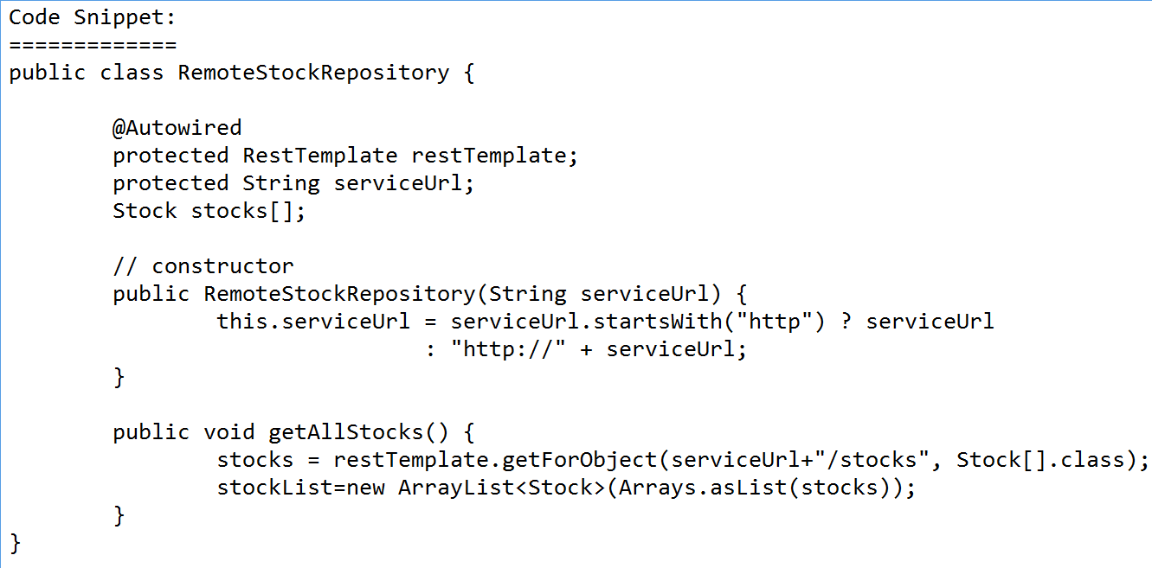
Microservices communication – RemoteStockRepository class (user-defined)

Slide 50
Microservices communication
Now, you can call the methods from this RemoteStockRepository methods from the CustomerController method:
Define a method getCustomerStock() in CustomerController class for GET HTTP request
Accept a customer id in this method
Look for the Customer object for this id
Get the array of stock ids from the Customer object
For every stock id, access Stock microservice, get the Stock details (name, amount etc)
Add this Stock object into ArrayList and return

Slide 51
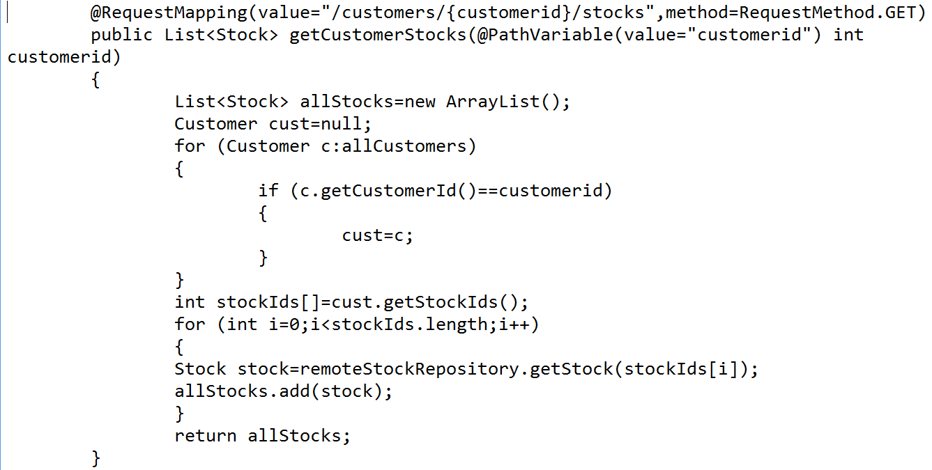
Microservices communication

Slide 52
Hands on
Create a microservice “SecurityBond”
The information we should get is:
Input: Security Bond Id
Output:
issueType (‘public’ or ‘private’)
issuerName:ICICI Bank Limited, L&T Finance Ltd. Etc
ISIN: International Securities Identification Number
Symbol
totalNumberOfBonds
faceValue
issuePrice

Slide 53
Hands on
Now, every customer should have:
A list of Stocks (already implemented)
A list of security bonds (need to implement)
We should be able to access SecurityBond microservice independently
Given a security bond: Fetch details about this bond
List all available security bond details

Slide 54
Hands on
For a given customer id, it should communicate to both Stock microservice and SecurityBond microservice and list out the details as:
Input: CustomerId: 1
Output: Customer Name, Address, List of stock details, List of SecurityBond details

Slide 55
What is microservice?
Now, our application is made up of the following microservices:
Customer microservice
Stock microservice
SecurityBond microservice
If one microservice fails, then the others can still work (THIS IS THE ADVANTAGE)
For testing purpose, you can shutdown Stock microservice and try to access others, it should work

Slide 56
End of Microservices Architecuture with Spring Boot

